Slide 1

International Conference on Advanced Research in Electronics and Communication Systems
(ICARECS-2025)
26th & 27th February 2025
Retinal Disease Detection and Classification Using Convolutional Neural Networks and Transfer Learning
Aditya Agarwal¹, Rohan Gupta1, Abhinav Panwar¹, R. Loganathan¹, S. Latha^{1,*}, P. Muthu², Samiappan Dhanalakshmi¹
Presenting Author: Aditya Agarwal, Abhinav Panwar
Department of Electronic and Communication Engineering, S.R.M Institute of Science and Technology
Submission ID: 338
Track 1: 26-Feb-2025

Slide 2


Retinal Disease Detection and Classification Using Convolutional Neural Networks and Transfer Learning Paper ID:-338
Outline of Presentation
Introduction
Motivation & Objectives
Workflow
Technology Stack
Results
References
International Conference on Advanced Research in Electronics and Communication Systems
(ICARECS-2025)
(26-27 February, 2025)

Slide 3
Retinal Disease Detection and Classification Using Convolutional Neural Networks and Transfer Learning Paper ID:- 338
INTRODUCTION
This project focuses on developing an AI-powered system to detect macular abnormalities from OCT images for early AMD diagnosis.
AMD affects 8.7% of the global population, making early detection crucial.
Manual OCT analysis is slow, labor-intensive, and prone to errors.
Machine learning models enhance accuracy, efficiency, and accessibility.
Aims to reduce diagnostic workload and improve patient outcomes.
International Conference on Advanced Research in Electronics and Communication Systems
(ICARECS-2025)
(26-27 February, 2025)

Slide 4
Retinal Disease Detection and Classification Using Convolutional Neural Networks and Transfer Learning Paper ID:-338
MOTIVATION
Automates OCT image classification, reducing manual workload.
Improves accuracy and consistency in detecting macular abnormalities.
Addresses the scarcity of labeled medical data through transfer learning.
International Conference on Advanced Research in Electronics and Communication Systems
(ICARECS-2025)
(26-27 February, 2025)

Slide 5
Retinal Disease Detection and Classification Using Convolutional Neural Networks and Transfer Learning Paper ID:-338
OBJECTIVE
To analyze transfer learning for performance enhancement, integrate a fine-tuned pre-trained, and custom CNN for retinal image classification, and ensure rapid, reliable normal-abnormal categorization.
International Conference on Advanced Research in Electronics and Communication Systems
(ICARECS-2025)
(26-27 February, 2025)

Slide 6
Retinal Disease Detection and Classification Using Convolutional Neural Networks and Transfer Learning Paper ID:-338
WORKFLOW
Train Test validation
Selecting Different CNN Models for training and testing purpose
Classifying the data as multiclass and binary class for both training and testing.
Preprocessing of Data
Collection of Dataset
Hereafter, we propose our own CNN model with different number layers for better accuracy results.
Analysing the Resnet50 Model in binary class and Multi with diff. Learning rate and optimizers.
Going with another CNN model: MobileNet for better accuracy for the classification.
CNN5, CNN7, CNN9 and also combining two models
Classifying all outputs and making a comparison analysis and integrating this with the web application stack.
Output
International Conference on Advanced Research in Electronics and Communication Systems
(ICARECS-2025)
(26-27 February, 2025)

Slide 7
Retinal Disease Detection and Classification Using Convolutional Neural Networks and Transfer Learning Paper ID:-338
TECHNOLOGY STACK
Core Components:
Frontend Development:
HTML5: Structure of the web pages.
CSS: Styling and layout for an interactive user interface.
JavaScript: Provides dynamic content and improves user experience.
Backend Development:
Flask (Python):
Lightweight and efficient framework for building web applications.
Facilitates communication between the web interface and the AI model.
AI and Image Processing:
TensorFlow, PyTorch, TorchVision and Pillow: Implement deep learning models for image classification.
Integration:
The frontend will communicate with the backend (Flask) to send OCT images for analysis.
The backend processes the images using the CNN model and returns the results (normal/abnormal classification) to the frontend.
International Conference on Advanced Research in Electronics and Communication Systems
(ICARECS-2025)
(26-27 February, 2025)

Slide 8
Retinal Disease Detection and Classification Using Convolutional Neural Networks and Transfer Learning Paper ID:-338
RESULTS
The deep models used in the project were compared based on classification accuracy of OCT images into normal and AMD classes. The performance measures used to evaluate the performance of the models are accuracy, computational cost, and dataset variation robustness. Both binary classification (sorting images between AMD and normal) and multiclass classification experiments were performed.
Accuracy: The deep learning models achieved high accuracy in classifying OCT images into AMD and normal categories, with the binary classification model performing better than the multiclass classification model.
Binary Classification Results: The model attained an accuracy of 100%, effectively in the Normal-CNV category with high sensitivity and specificity.
Multiclass Classification Results: When classifying images into multiple categories, the model achieved an accuracy of 98%, with challenges in differentiating between certain retinal conditions..
Real-Time Integration: The trained model was designed to be deployable in real-time clinical settings, assisting ophthalmologists in early detection of AMD through an automated diagnosis system.
International Conference on Advanced Research in Electronics and Communication Systems
(ICARECS-2025)
(26-27 February, 2025)

Slide 9
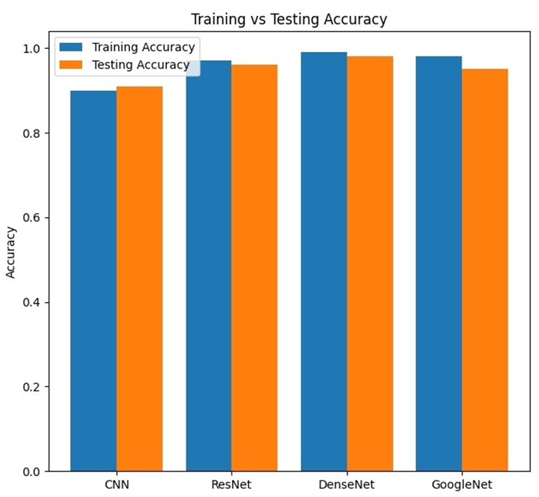
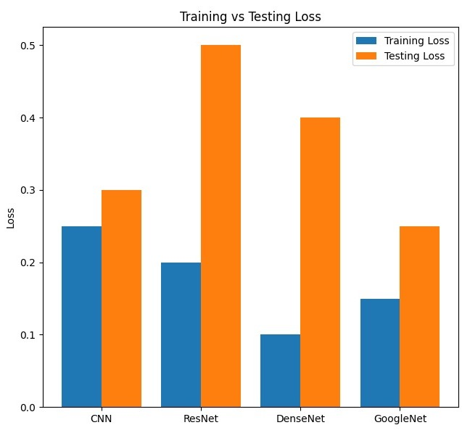
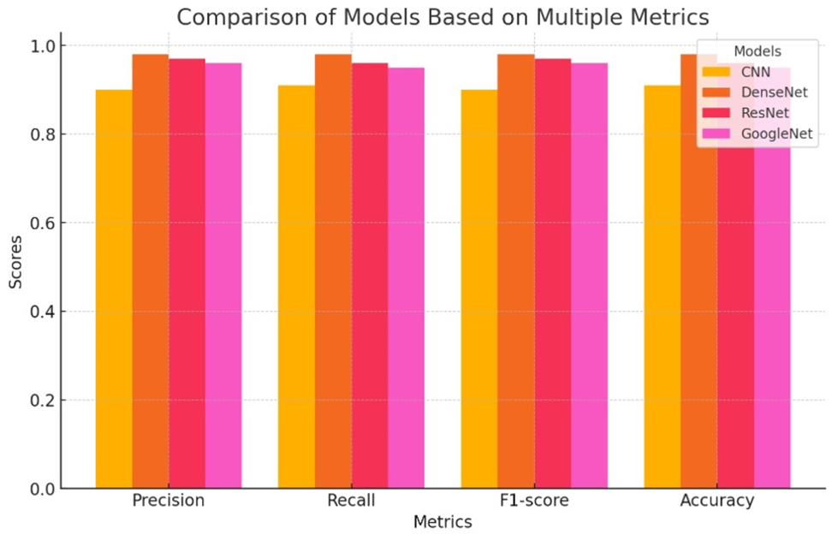
Retinal Disease Detection and Classification Using Convolutional Neural Networks and Transfer Learning Paper ID:-338
Cont.
Figure.2: Multiclass Model Evaulation
Figure.3: Multiclass Model’s Accuracy graph
Figure.4: Multiclass Model’s loss graph
Inference: In our study, we evaluated multiple deep learning models, including CNN, ResNet50, GoogleNet, and DenseNet, for multiclass classification of OCT images. After extensive testing, DenseNet emerged as the best-performing model, achieving the highest accuracy.
From the above graphs, it is predicted that the DenseNet has the largest accuracy as compared with others achieving total accuracy of 98% with respectively accuracy and loss.
International Conference on Advanced Research in Electronics and Communication Systems
(ICARECS-2025)
(26-27 February, 2025)

Slide 10
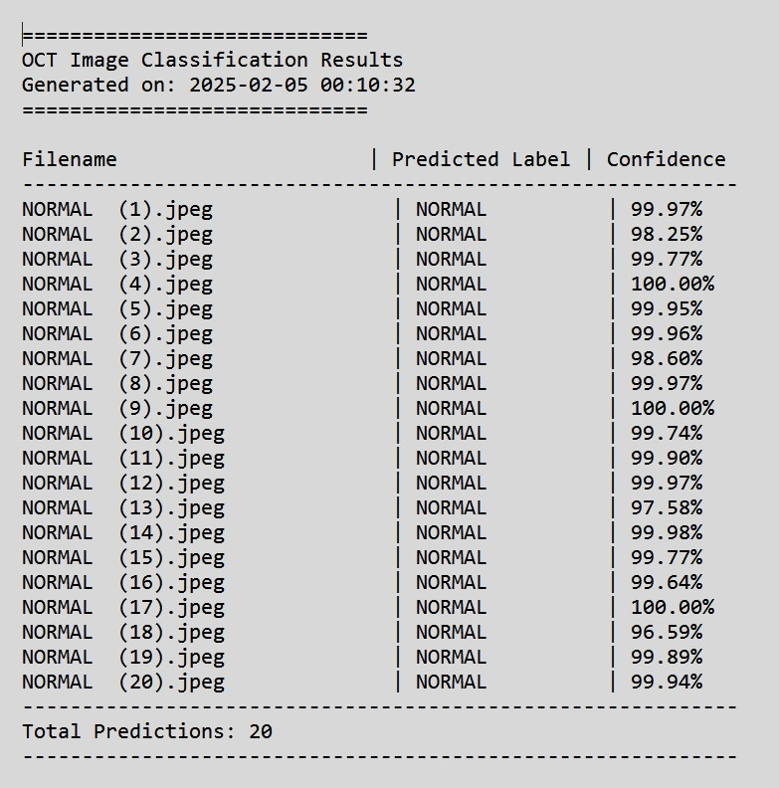

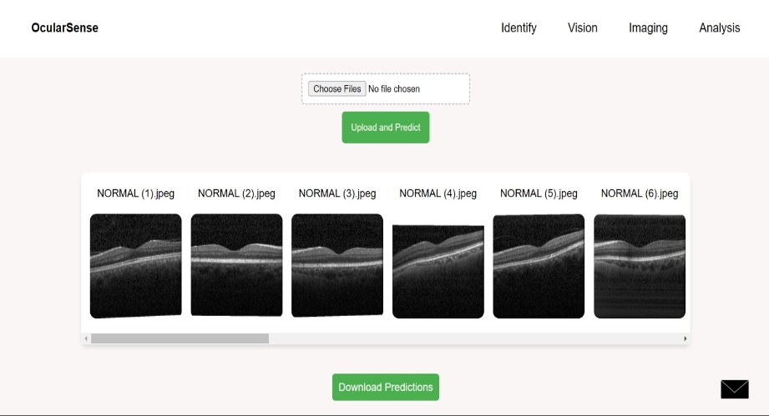
Retinal Disease Detection and Classification Using Convolutional Neural Networks and Transfer Learning Paper ID:-338
Cont.
Steps to Access Our Web Application:
Connect to Wi-Fi – Ensure your device is connected to the ocularsense network.
Scan the QR Code – Use your mobile or laptop to scan the QR code displayed on the slide.
Log In – Enter the following credentials:
Username: admin
Password: 123
Once logged in, you can select multiple OCT scans from the database for prediction. The results will be generated instantaneously, and you can download the predictions as a .txt file for further reference.
Figure.5: Sample Webapp image Figure.6: Output Predictions
International Conference on Advanced Research in Electronics and Communication Systems
(ICARECS-2025)
(26-27 February, 2025)

Slide 11
Retinal Disease Detection and Classification Using Convolutional Neural Networks and Transfer Learning Paper ID:-338
CONCLUSION
In short, the research successfully implemented and compared the various deep learning architectures of CNN, ResNet50, GoogleNet, and DenseNet for OCT image classification. Among the four, DenseNet had the best accuracy of 98% and therefore the best precision, recall, and F1-score performance. The model was trained using the Adam optimizer with a learning rate of 0.001, which yielded the best convergence and efficiency. A web application was also created to facilitate easy monitoring and diagnosis and therefore deployable in hospitals.
In the future, the system can be developed further with bigger and more varied datasets, so it can be more effective for complicated cases. Additionally, more sophisticated deep learning methods like transformer-based models or self-supervised learning can be used to further enhance classification accuracy. Cloud-based integration of medical record systems and real-time image processing functionality can also be added to make it more practically implemented in healthcare environments. With ongoing optimization and enhancement of this system, it can have the potential to be a trusted AI-powered diagnostic tool for ophthalmologists to enhance early diagnosis and treatment of retinal disease.
International Conference on Advanced Research in Electronics and Communication Systems
(ICARECS-2025)
(26-27 February, 2025)

Slide 12
Retinal Disease Detection and Classification Using Convolutional Neural Networks and Transfer Learning Paper ID:-338
REFERENCES
[1] K. Patil, A. Mahajan, S. Balamurugan, P. Arulmozhivarman and R. Makkar, "Development of Signal Processing Algorithm for Optical Coherence Tomography", Proc. 2020 IEEE Int. Conf. Commun. Signal Process. ICCSP 2020, pp. 1283-1287, 2020.
[2] Y. Huang et al., "Noise-Powered Disentangled Representation for Unsupervised Speckle Reduction of Optical Coherence Tomography Images," in IEEE Transactions on Medical Imaging, vol. 40, no. 10, pp. 2600-2614, Oct. 2021, doi: 10.1109/TMI.2020.3045207.
[3] keywords: {Noise measurement;Speckle;Generators;Noise reduction;Image reconstruction;Image denoising;Generative adversarial networks;Disentangled representation;optical coherence tomography;speckle reduction;unsupervised learning},
[4] M. D. Abràmoff, M. K. Garvin and M. Sonka, "Retinal imaging and image analysis", IEEE Rev. Biomed. Eng., vol. 3, pp. 169-208, 2022.
[5] Y. Roh, G. Heo and S. E. Whang, "A survey on data collection for machine learning: a big data-ai integration perspective", IEEE Transactions on Knowledge and Data Engineering
[6] Kulyabin, Mikhail; Zhdanov, Aleksei; Nikiforova, Anastasia; Stepichev, Andrey; Kuznetsova, Anna; Borisov, Vasilii; Ronkin, Mikhail; Bogachev, Alexander; Korotkich, Sergey; Maier, Andreas (2024), “OCTDL: Optical Coherence Tomography Dataset for Image-Based Deep Learning Methods”, Mendeley Data, V4, doi: 10.17632/sncdhf53xc.4
International Conference on Advanced Research in Electronics and Communication Systems
(ICARECS-2025)
(26-27 February, 2025)

